Slide 1


KPMG Project
Alexis Losenko
Marco Tampieri
Niels Stevens
Pierro Simon
Sébastien Pardon

Slide 2
Problem
In order to improve their efficiency, how could we help the KPMG legal department to simplify the consultation of the status of Belgian companies?
Moreover, could we give them better insight in the information that they currently have?

Slide 3
Steps
Pdf Scrapping
O.C.R
DB compiling (MongoDB)
Metadata Scrapping
Extraction of articles
Translation
Language detection
NLP Model to classify articles
Front-end

Slide 4










Technologies used
Scrapping & OCR
Storage
Gain of information

Slide 5
Main challenges
In a short time, gain enough knowledge to present some results.
Understand well enough the needs of the KPMG legal department to give them a helpful solution
Give the opportunity to each team member to deal with each part

Slide 6
How did we cope with those challenges ?
Discuss and share knowledge between each other
Use everybody’s skills
A lot of google researches

Slide 7
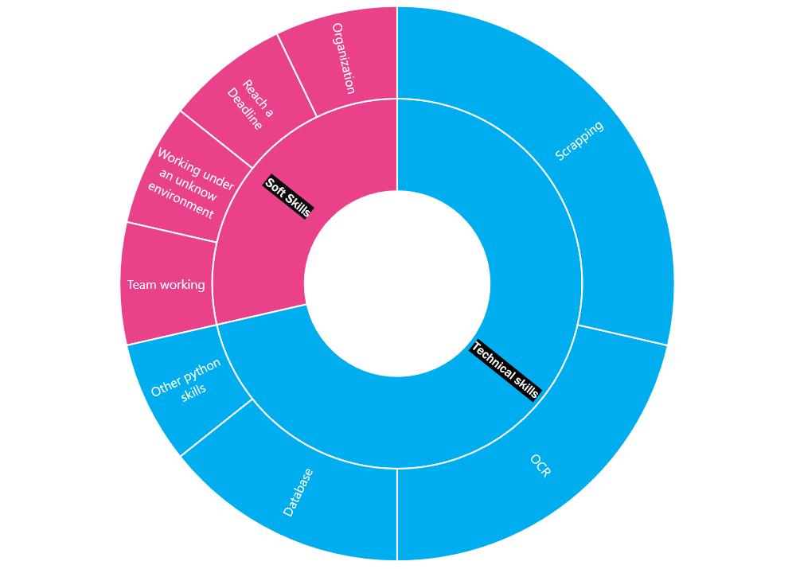
What did we learn?

Slide 8
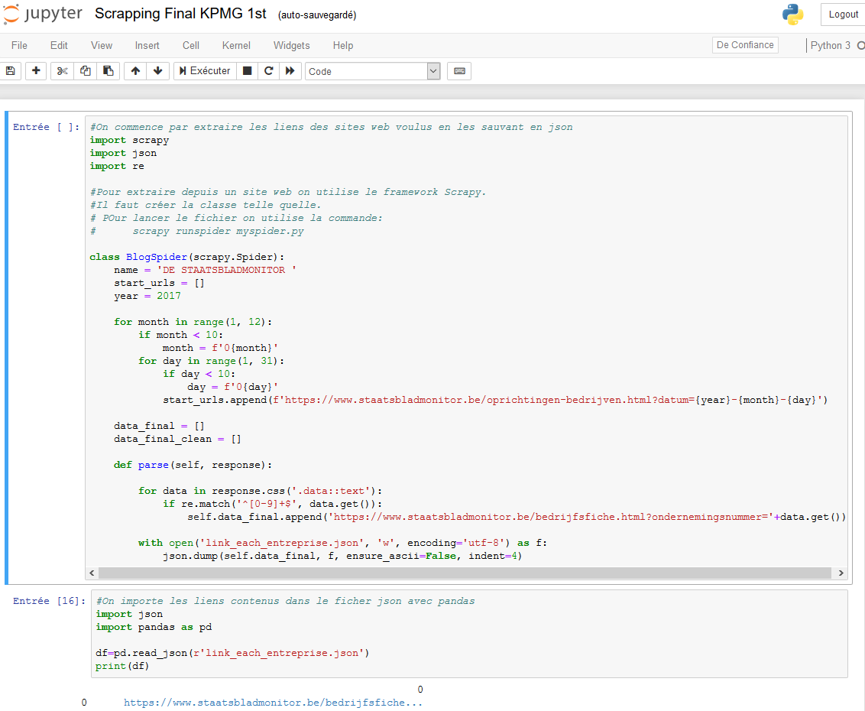
Demo

Slide 9
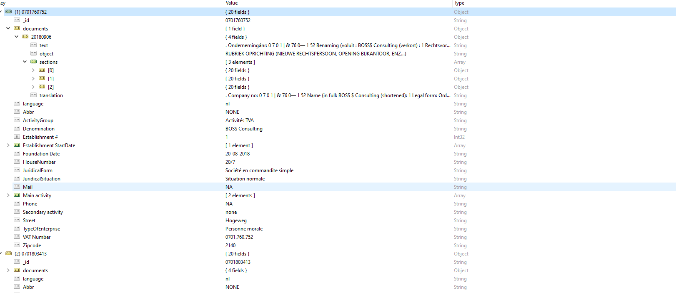

Slide 10
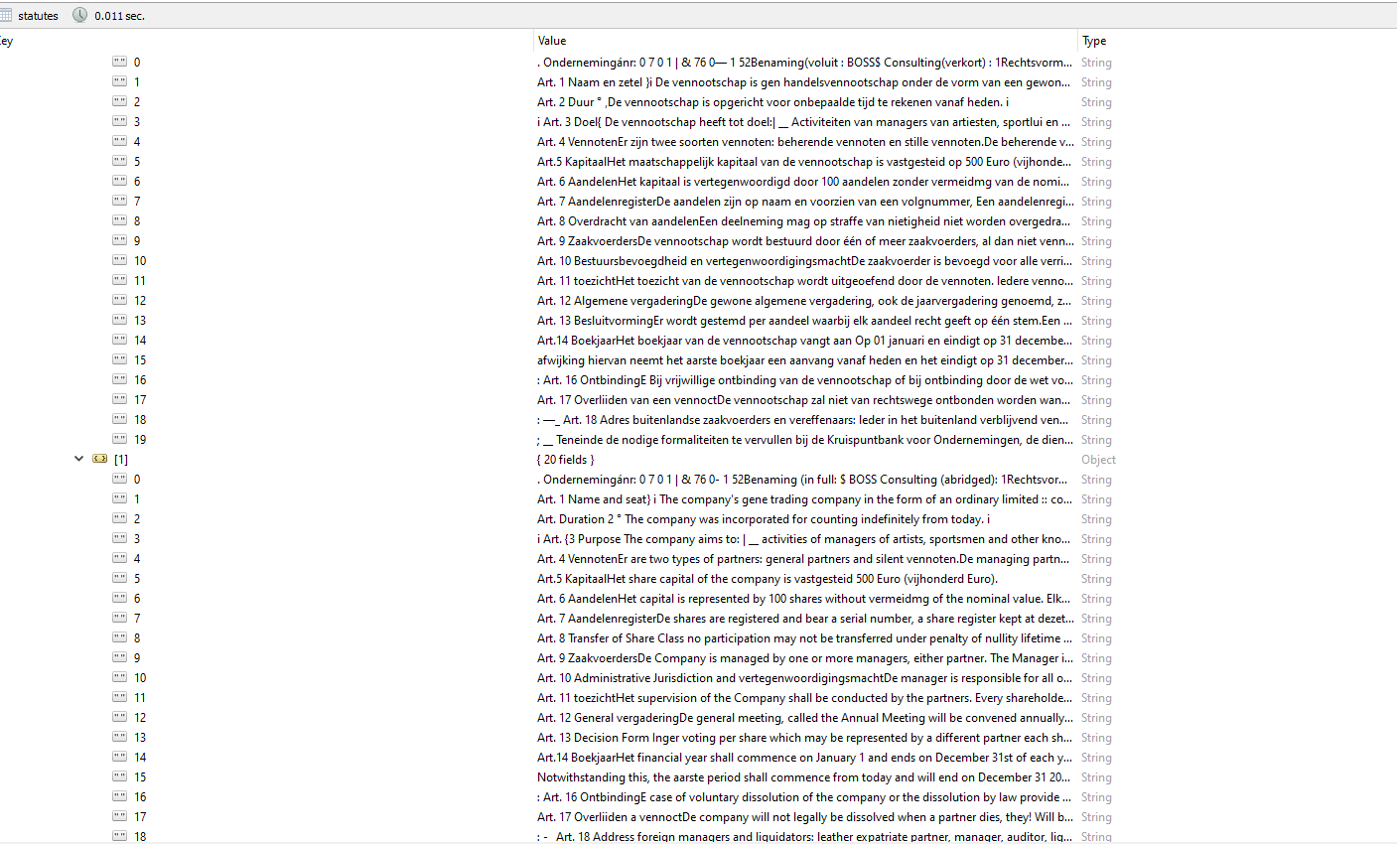

Slide 11
Thanks for this preview but what’s next?

Slide 12
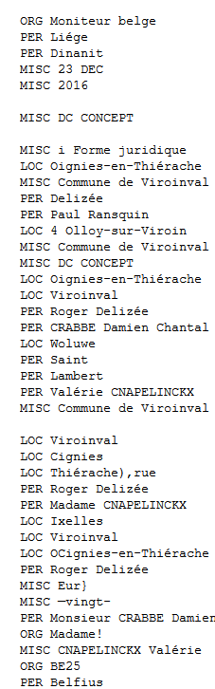
Things to improve
OCR
Front-end list page
Entity detection (own model VS Amazon Comprehend, Google NLP,…)
Translation
New legislation: updates needed before 2024 due to new company types

Slide 13


Things to be done
3 languages or +
Integrate financial reports & predictions
Follow a company/a sector:
Notification for additions/modification
Notification for the General Meetings
Crossover of Investors/board members
Lookup of competitors:
inside the same sector/corporate purpose

Slide 14

Our technology can be applied to do:
Competitive intelligence
Be aware of any new competitor in the market
Financial analysis
Follow companies
Get new business opportunities:
contact companies when the law is changing

Slide 15
Thank you for your attention
Any questions?

